Slide 1
Assalam_O_Alaikum

Slide 2

Operating System(Lab) Lab Task 1
Shaheed Zulfikar Ali Bhutto Institute of Science & Technology
COMPUTER SCIENCE DEPARTMENT
Name : Syed Abdul Sami Shah
Reg no : 2180234
Section : SE 4A
Submitted to : Sheikh Badar Ud din Tahir

Slide 3
Installation Process of Vmware WorkStation
Shaheed Zulfikar Ali Bhutto Institute of Science & Technology
COMPUTER SCIENCE DEPARTMENT
First of all open google chrome on your laptop or pc,
In Search bar search for “Vmware Workstation” download for pc.
Then Click the first website and and interface given below will be opened and through that push the download button.

Slide 4
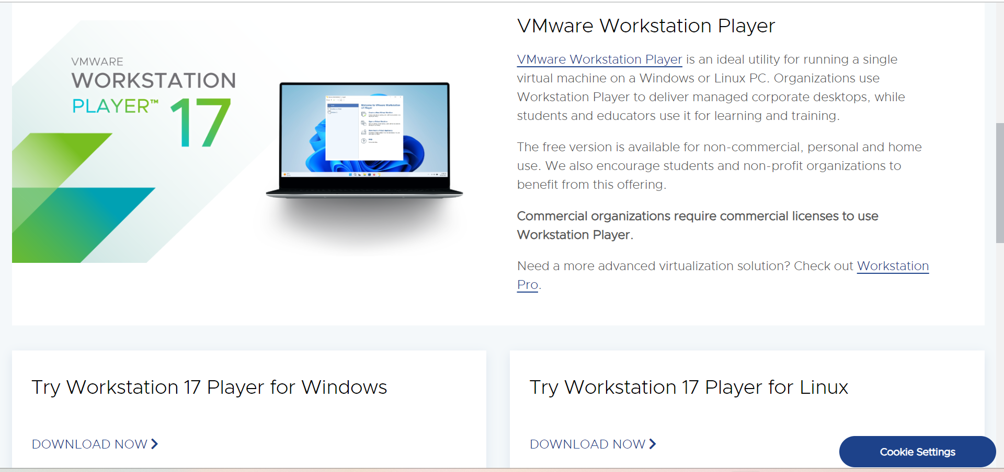
Screenshot of VmWare Workstation Platform
Shaheed Zulfikar Ali Bhutto Institute of Science & Technology
COMPUTER SCIENCE DEPARTMENT

Slide 5
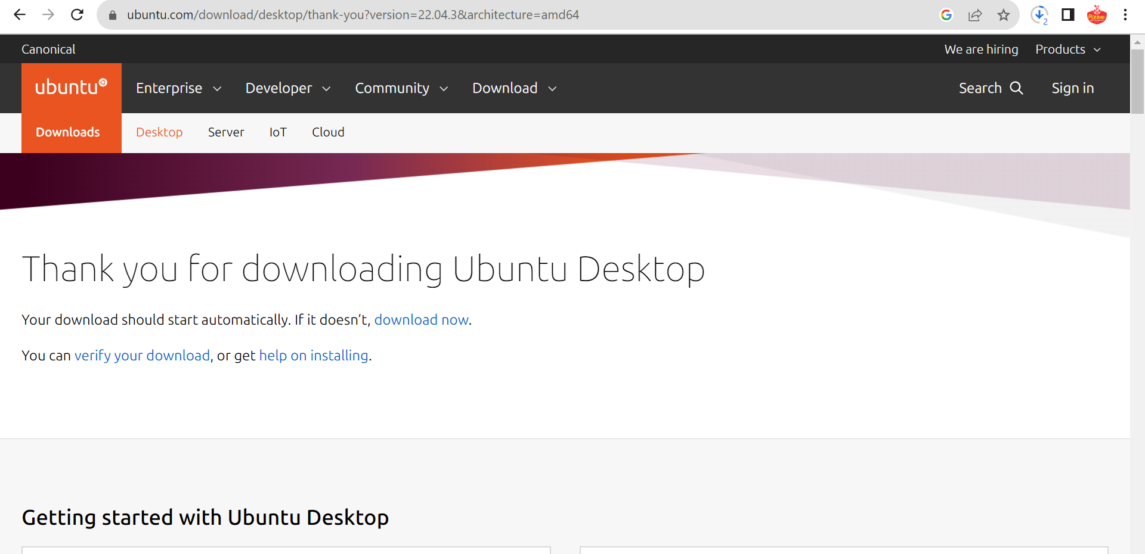
Ubuntu downloading PlatForm
Shaheed Zulfikar Ali Bhutto Institute of Science & Technology
COMPUTER SCIENCE DEPARTMENT

